Slide 1
Image Processing And Computer Vision

Slide 2
Introduction
Three implementation to detect 10 images
Implementations:
SmallerVGGNet – Trained the dataset manually and detection
Retinanet – Trained dataset and classification of 10 categories
Mobilenet – Lightweight implementation and a trained dataset

Slide 3
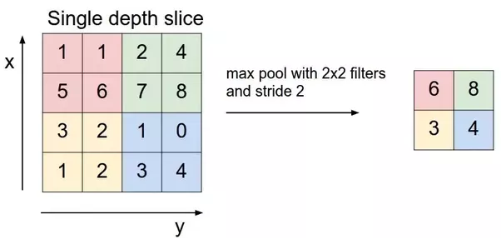

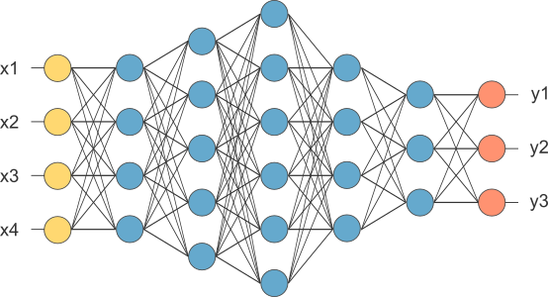
Convolutional Neural Network (CNN)
Convolutional Layers
Pooling Layer
A Set of Fully Connected Layers
Notes:
Convolutional layer is the very first layer where we extract features from the images in our datasets. Due to the fact that pixels are only related with the adjacent and close pixels, convolution allows us to preserve the relationship between different parts of an image. Convolution is basically filtering the image with a smaller pixel filter to decrease the size of the image without loosing the relationship between pixels. When we apply convolution to 5x5 image by using a 3x3 filter with 1x1 stride (1 pixel shift at each step). We will end up having a 3x3 output (64% decrease in complexity).
When constructing CNNs, it is common to insert pooling layers after each convolution layer to reduce the spatial size of the representation to reduce the parameter counts which reduces the computational complexity. In addition, pooling layers also helps with the overfitting problem. Basically we select a pooling size to reduce the amount of the parameters by selecting the maximum, average, or sum values inside these pixels. Max Pooling, one of the most common pooling techniques, may be demonstrated as follows:
A fully connected network is our RegularNet where each parameter is linked to one another to determine the true relation and effect of each parameter on the labels. Since our time-space complexity is vastly reduced thanks to convolution and pooling layers, we can construct a fully connected network in the end to classify our images. A set of fully connected layers looks like this:

Slide 4
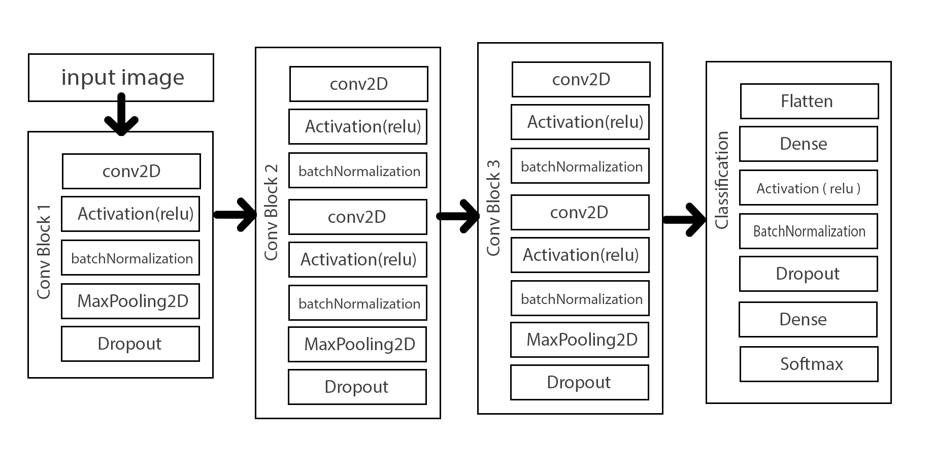
SmallerVGGNet
Is a simplified version of VGGNet which was introduced by Simonyan and Zisserman ( 2014 )
ReLU activation used
Batch Normalization (BN)
Notes:
ReLU is the most commonly used activation function in neural networks, especially in CNNs. If you are unsure what activation function to use in your network, ReLU is usually a good first choice.
ReLU is linear (identity) for all positive values, and zero for all negative values. This means that:
It’s cheap to compute as there is no complicated math. The model can therefore take less time to train or run.
It converges faster. Linearity means that the slope doesn’t plateau, or “saturate,” when x gets large. It doesn’t have the vanishing gradient problem suffered by other activation functions like sigmoid or tanh.
It’s sparsely activated. Since ReLU is zero for all negative inputs, it’s likely for any given unit to not activate at all. This is often desirable (see below).
Batch Normalization is used to normalize the input layer as well as hidden layers by adjusting mean and scaling of the activations. Because of this normalizing effect with additional layer in deep neural networks, the network can use higher learning rate without vanishing or exploding gradients. Furthermore, batch normalization regularizes the network such that it is easier to generalize, and it is thus unnecessary to use dropout to mitigate overfitting.
Right after calculating the linear function using say, the Dense() or Conv2D() in Keras, we use BatchNormalization() which calculates the linear function in a layer and then we add the non-linearity to the layer using Activation().

Slide 5
Retinanet
From the research paper : Focal Loss for Dense Object Detection
One stage detector like YOLO and SSD
More dense object detection ( more bounding boxes to better cover space of possible objects )
YOLOv1 – 98 boxes, YOLOv2 - ~1k boxes, SSD - ~8-26K, Retinanet - ~100k
Notes:
One stage detector like YOLO and SSD use something like sliding window detection. One stage is fast and single however 2 stage is more accurate.

Slide 6
Mobilenet
MobileNets are based on a streamlined architecture that uses depth-wise separable convolutions to build light weight deep neural networks.
Trained using 17 Layers of Convolution
Convolution Layer Kernal size – 3
Weight_filler is msra
Activation is ReLu
Flatten
PriorBox - multiple boxes for every feature point are called priors
Softmax for classification to calculate the probability for every possible class

